Slide 1
Conditionals

Slide 2
Conditional Statements
If
If else
switch

Slide 3
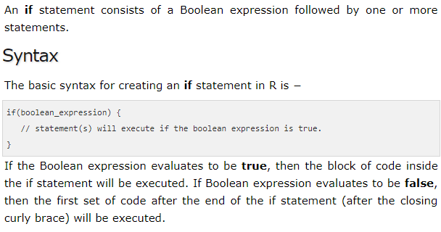
If statement

Slide 4

Example

Slide 5
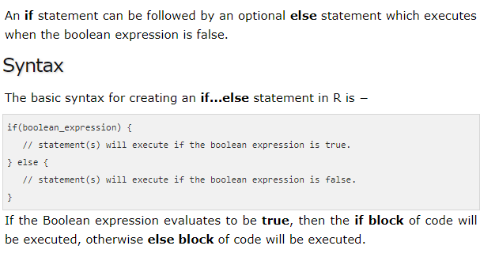
If else

Slide 6
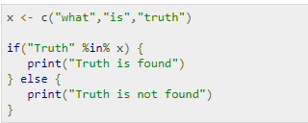

Slide 7
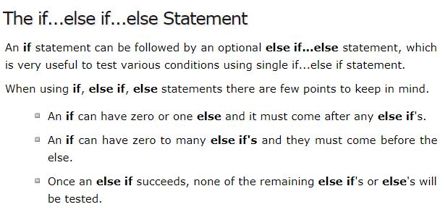

Slide 8
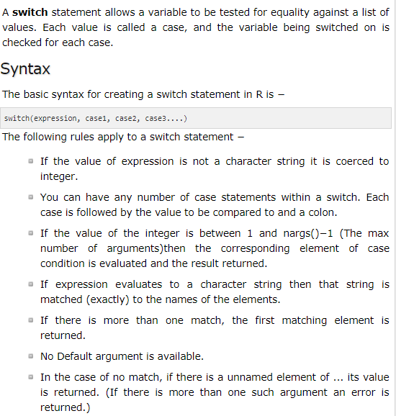

Slide 9
